Slide 1
The story of CoVid-19 in the US
A data visualization approach: apr 2020 -apr 2021
Zihua Lai & Daniela Quintero Narváez

Slide 2
Guideline
Introduction : We used the data from “The COVID Tracking Project” combined with USA shapefile to tell the story
Aim : Focus on Mortality and analyze why.
Step1 : Preprocessing of huge amount of Missing Value
Step2 : State Wise Pattern Analysis of Mortality
Step3 : Time Wise Pattern Analysis of Mortality

Slide 3
HUge NAs

Slide 4
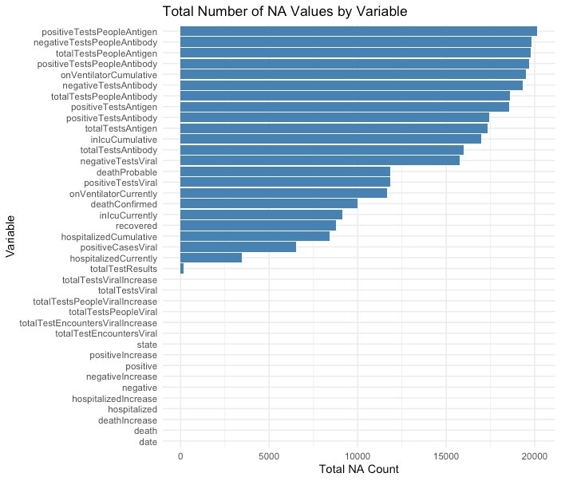
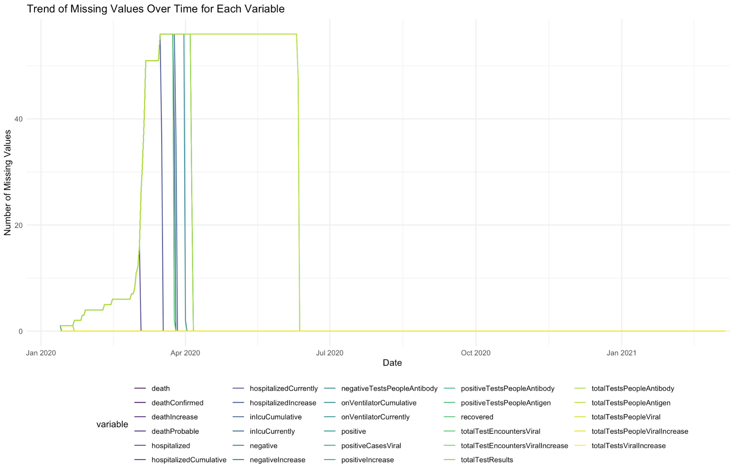
BEFORE WE BEGIN…
disclaimer!
Data collection problem :(

Slide 5
Spatial pattern

Slide 6
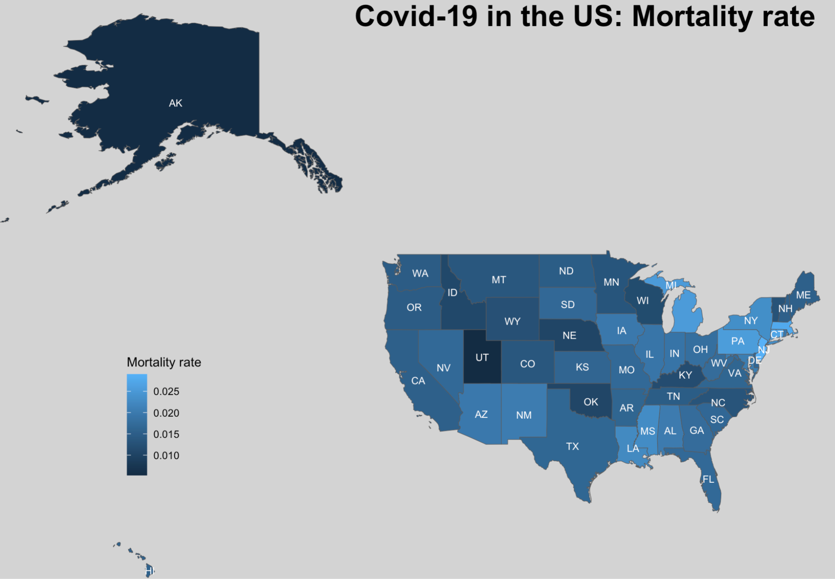
Covid-19 in the US: mortality rate
U.S MORTALITY RATE:
1.7%
TOTAL INFECTED:
~ 29 M
TOTAL DEATHS:
> 450 k
From Apr 2020 - Apr 2021
Notes:
Total pandemic: ended with around 103M infected, and 1 M deaths :(

Slide 7
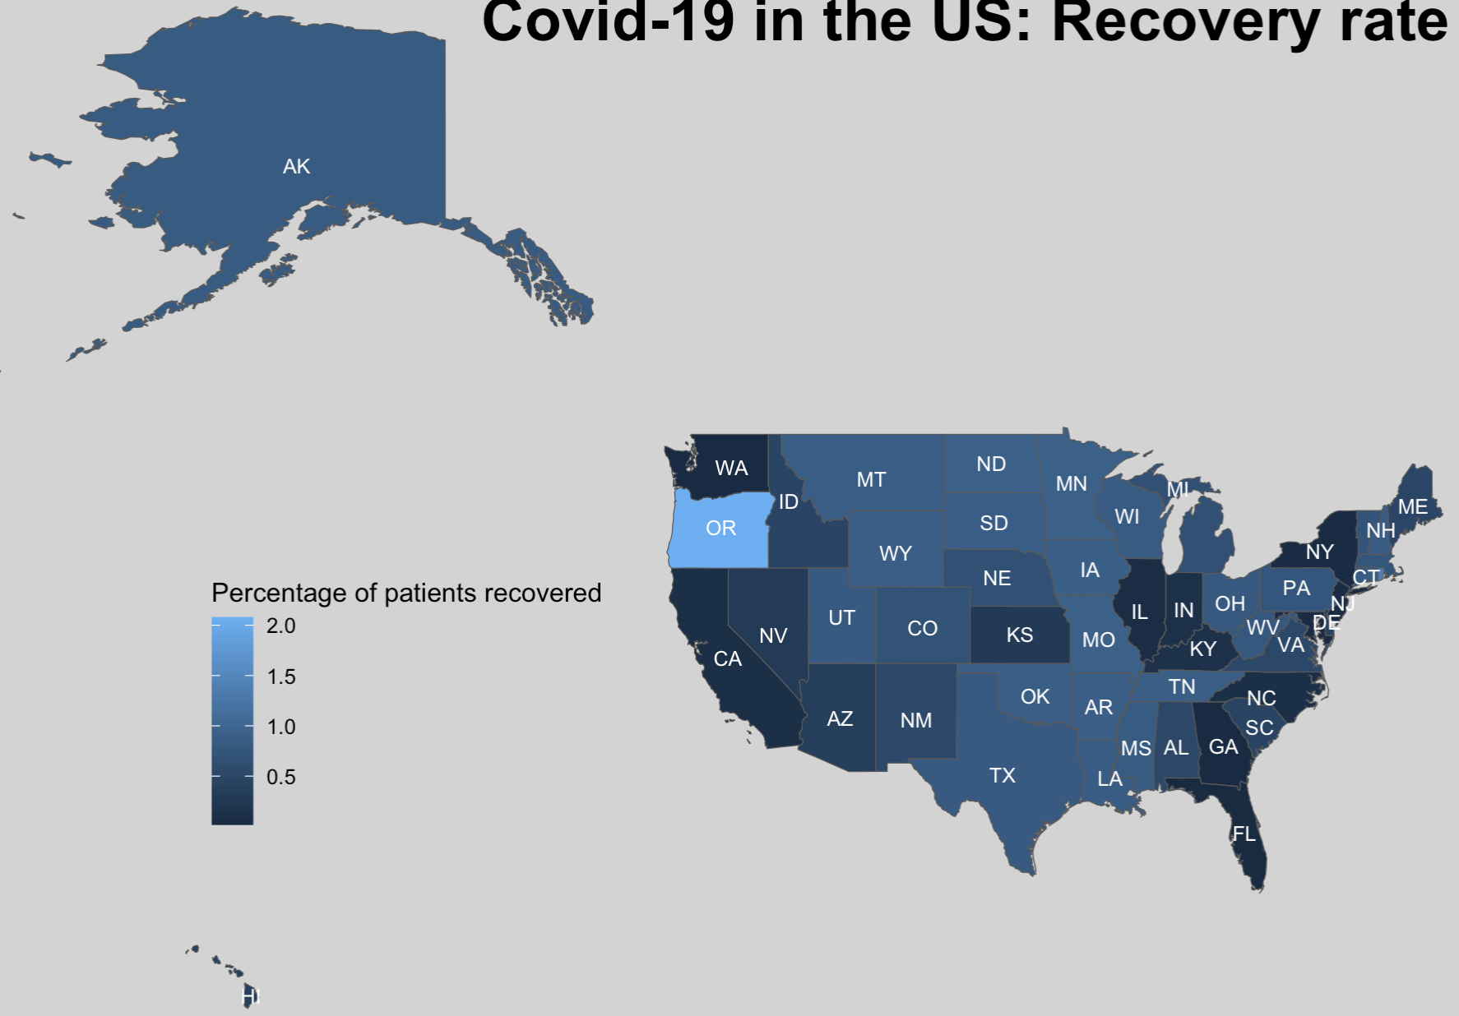
Covid-19 in the US:
Recovery rate
DOES OREGON HAVE BETTER HC SYSTEM?
Is it related to hc capacity?
Long-term recovering facilities
From Apr 2020 - Apr 2021
Notes:
OR is ranked #21 in best healthcare facilities in the US.

Slide 8
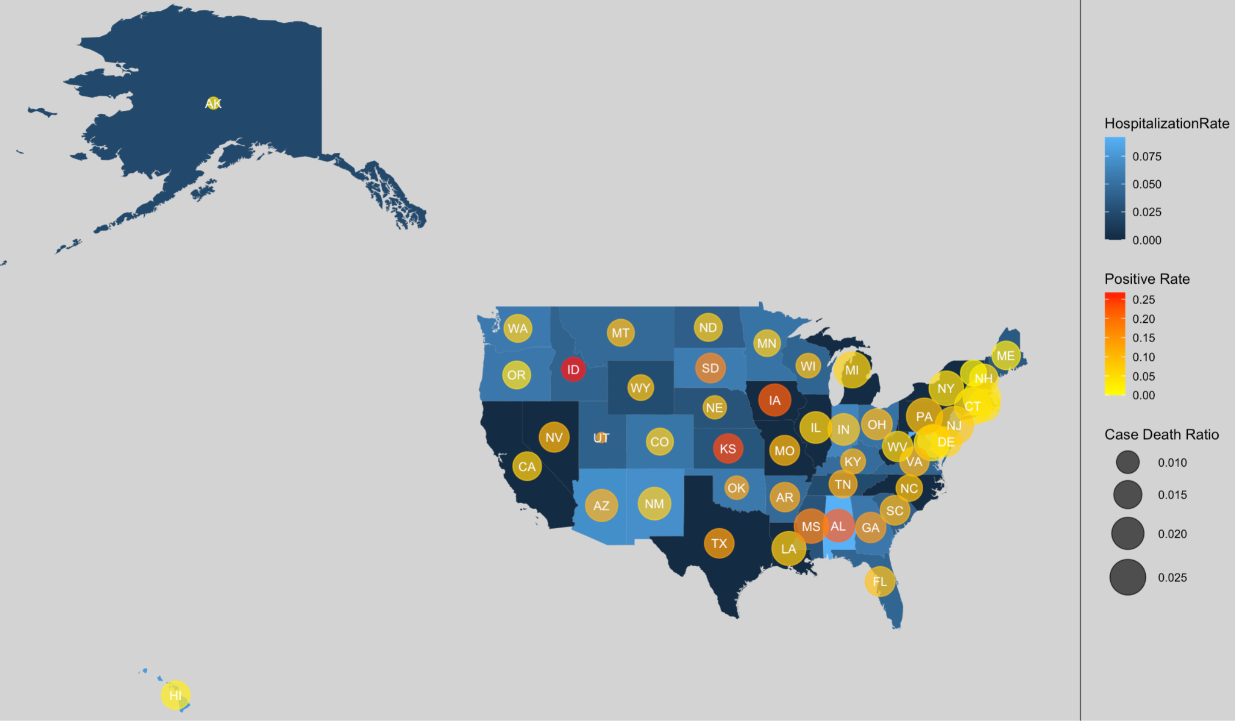
CoV-19 in the US: hospitalizations, cases & mortality rates

Slide 9
CoV-19 in the US: hospitalizations, cases & mortality rates
Top 12 in each category

Slide 10
Time pattern

Slide 11
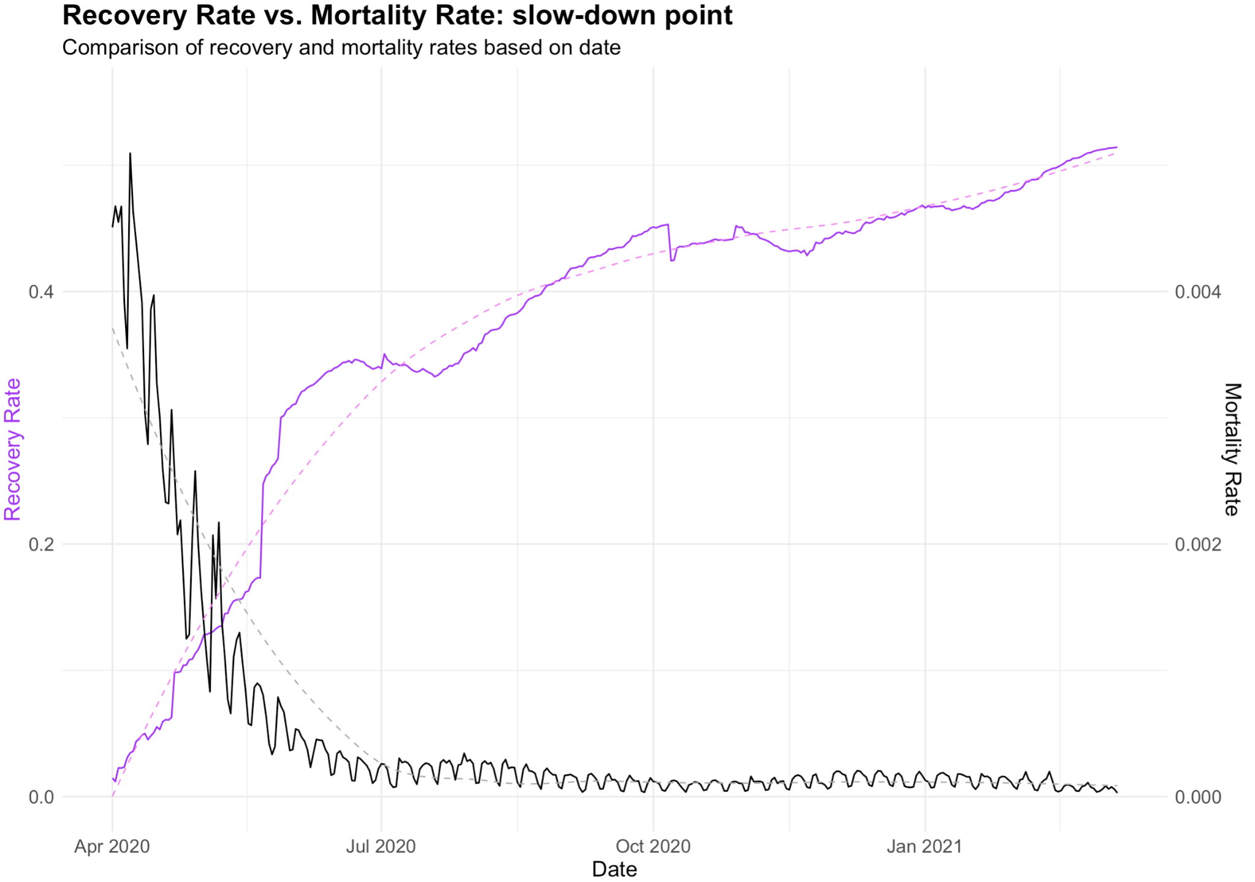
Evolution of COVID-19 Recovery Rate Vs. Mortality rate
Lock down in U.S started in March.
Is visible that it was an effective measure to slow down the deaths (prevention).

Slide 12
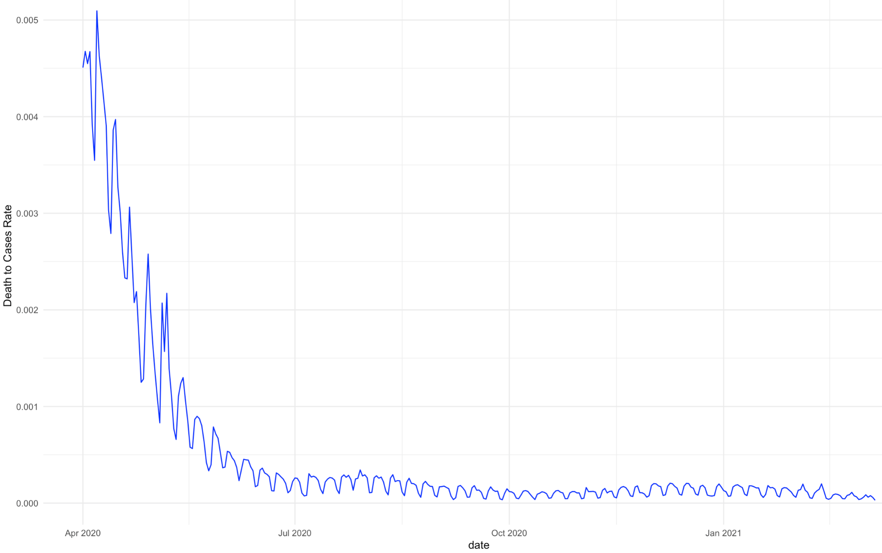
Focus on Mortality rATE
Trend: Sharp decline early in the timeline, which flattens out as time progresses.
Reason 1: Initially high mortality rate when the virus first emerged
Reason 2 : Over time, as treatments improved and better protocols were put in place, the death rate relative to positive cases decreased and stabilized.

Slide 13
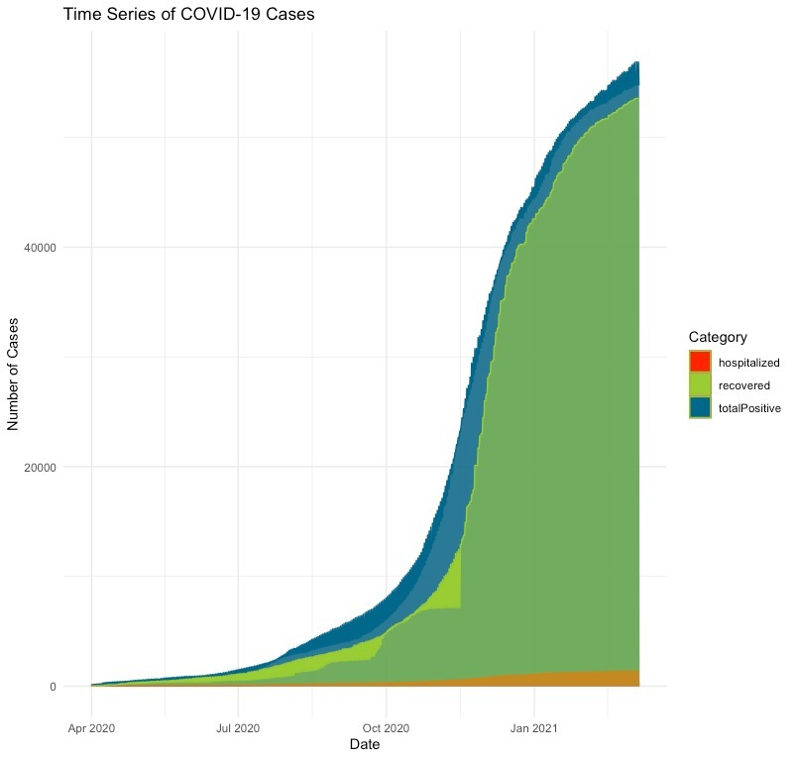
Covid-19 Hospitalized, Recovered And Test Over Time
Stack plot
over time, the number of recovered cases is increasing, which is a positive sign.
Improved Treatments
Vaccinations and Immunity(In the future, probably we can do the analysis for antibody and antigen)
However, the total number of positive cases is also growing, though this could be due to:
Increased Testing
Spread of Virus

Slide 14
1.2%
Statistics of Covid-19 in the US close with
fatality rate;
Taking more than 1.1 M lives.

Slide 15
It is our pleasure to tell the story for you!

